Slide 1
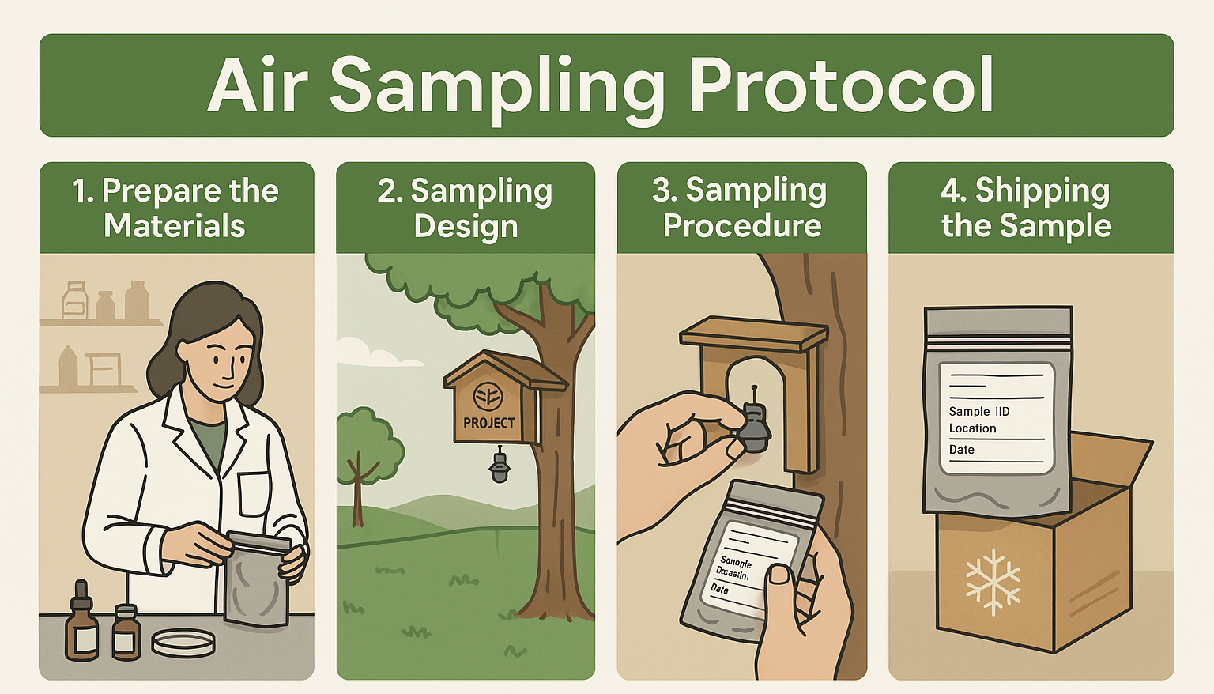
Air sampler and shelter, markers, gloves, ice packs, phone, measuring tape…
One (1) sampling site per location at ca. 1,6 m height, labelled and free of obstructions.
Open the pouch, label the sampler and clip it inside the shelter. Leave for 6 weeks.
Send to the Slovenian laboratory on dry ice.

Slide 2
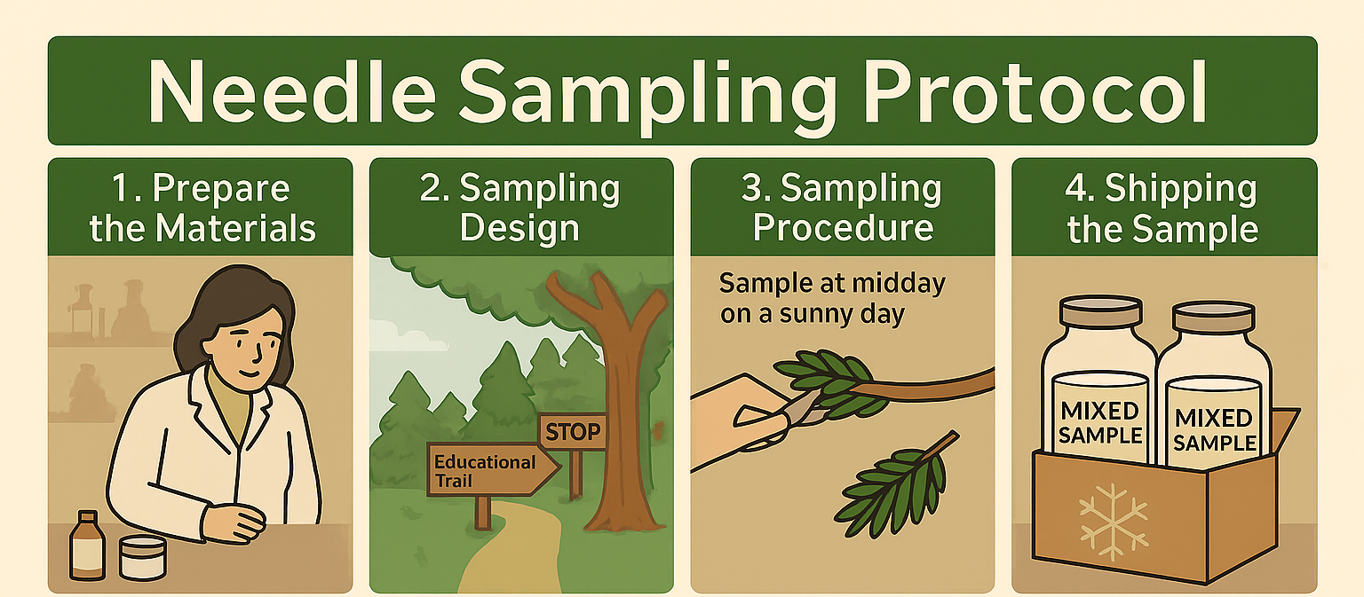
Shears, glass bottle, markers, gloves, ice packs, phone, measuring tape…
Five (5) sampling sites per location, select three (3) target species at all five points, in an undisturbed forest section.
At each sample point, collect needles from 3 trees at breathing-zone height so that you obtain one mixed sample (ca. two full 0,5 L bottles).
Send to the Slovenian laboratory on dry ice.

